Slide 1
Java Collections Framework Presented By: Purushottam Kumar

Slide 2
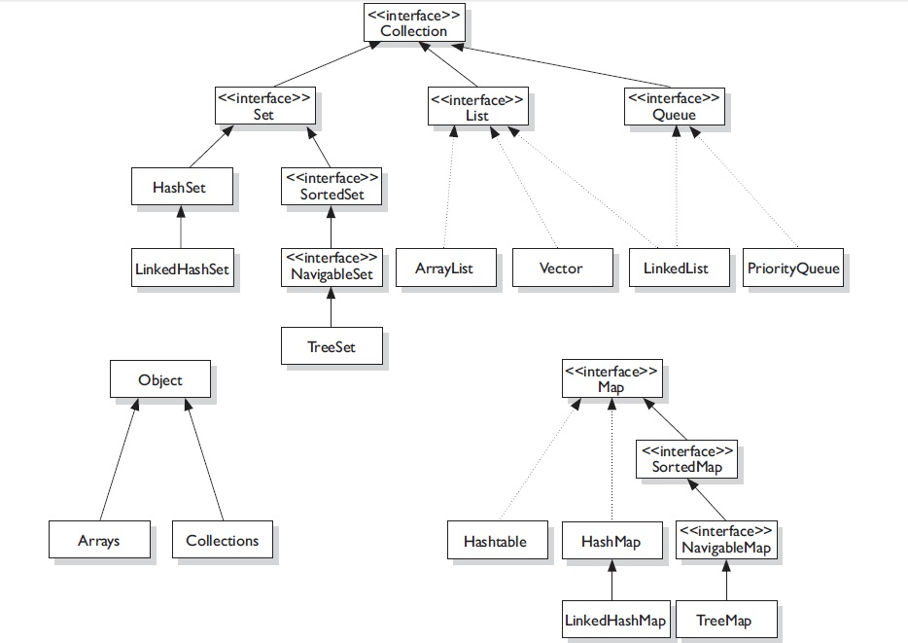
Collection Hierarchy

Slide 3
Map
A Map is an object that maps keys to values.
A map cannot contain duplicate keys.
Each key can map to at most one value.
HashTable
HashMap
LinkedHashMap
TreeMap

Slide 4
HashTable
This class implements a hashtable, which maps keys to values.
Any non-null object can be used as a key or as a value.
Is synchronized.
To successfully store and retrieve objects from a hashtable, the objects used as keys must implement the hashCode method and the equals method. (Will cover hashCode and equals methods in coming slides)
Default initialCapacity is 11 and default loadFactor is 0.75.
Can create HashTable in following ways,
Map h = new Hashtable();
Map h = new Hashtable(int initialCapacity) ;
Map h = new Hashtable(int initialCapacity, float loadFactor) ;

Slide 5
HashMap
Hash table based implementation of the Map interface.
Permits null values and the null key.
not synchronized
Default initialCapacity is 16 and default loadFactor is 0.75.
Internally useus hashCode() and equals() method. (Will cover hashCode and equals methods in coming slides)
Can create HashMap in following ways,
Map h = new HashMap ();
Map h = new HashMap(int initialCapacity) ;
Map h = new HashMap(int initialCapacity, float loadFactor) ;

Slide 6
equals() & hashCode()
public class StringEqualsTest {
public static void main(String[] args) {
Moofed m1 = new Moofed();
Moofed m2 = new Moofed();
System.out.println(m1.hashCode() == m2.hashCode());
System.out.println(m1.hashCode());
System.out.println(m2.hashCode());
System.out.println(m1.equals(m2));
}
}
class Moofed {
int i;
public Moofed(int a){
i=a;
}
}

Slide 7
O/P
false
16130931
26315233
false

Slide 8
public class StringEqualsTest {
public static void main(String[] args) {
Moofed m1 = new Moofed(1);
Moofed m2 = new Moofed(1);
System.out.println(m1.hashCode() == m2.hashCode());
System.out.println(m1.hashCode());
System.out.println(m2.hashCode());
System.out.println(m1.equals(m2));
}
}
class Moofed{
int i;
public Moofed(int a){
i=a;
}
@Override
public boolean equals(Object obj) {
Moofed m = (Moofed) obj;
if(i==m.i){
return true;
}
return false;
}
@Override
public int hashCode() {
return i*9;
}
}

Slide 9
O/P
true
9
9
True
Note: In previous example, we want to consider Moofed m1 = new Moofed(1); and Moofed m2 = new Moofed(1); as same object, that’s why we have overridden and implemented equals() method. And as per below rule no. 1, we have to override and implement hashCode method also.
Two Rules
If 2 objects are equal, then there hashCode must be equal.
But if 2 objects hashCode are equal, then that objects may or may not be equal.

Slide 10
HashMap Internal working..
public V put(K key, V value) {
if (key == null)
//If key is null, then Null keys always map to hash 0, thus index 0.
int hash = hash(key.hashCode());
// Some code to check if key already exists
//if key already exists will return value for the key, and duplicate entry wont be added.
//else
addEntry(hash, key, value, i);// value will be added to the bucket.
return null;
}

Slide 11
HashMap Internal working continue..
1. Public V get(Object key)
{
2. if (key ==null)
3. //Some code
4. int hash = hash(key.hashCode());
5. // if key found in hash table then return value
6. // else return null
}
For better understanding click http://javahungry.blogspot.com/2013/08/hashing-how-hash-map-works-in-java-or.html

Slide 12
LinkedHashMap
Hash table and linked list implementation of the Map interface, with predictable iteration order.
Permits null values and the null key.
maintains a doubly-linked.
not synchronized
Can create LinkedHashMap in following ways,
Map h = new LinkedHashMap ();
Map h = new LinkedHashMap(int initialCapacity) ;
Map h = new LinkedHashMap(int initialCapacity, float loadFactor) ;

Slide 13
TreeMap
The map is sorted according to the natural ordering of its keys, or by a Comparator provided at map creation time.
not synchronized.
Null key not allowed.
Slow.
Can create TreeMap in following ways,
Map h = new TreeMap();
Map h = new TreeMap(Comparator c) ;
Map h = new TreeMap(Map m);

Slide 14
Generics
Generics provide compile - time type safety for collections by allowing your Collection objects to specify what types they contain.
Do you see what the problem is?
ArrayList keywords = new ArrayList();
keywords.add(“java”);
keywords.add(“certification”);
keywords.add(new java.util.Date());
for(Object x : keywords) {
String temp = (String) x;
System.out.println(temp.toUpperCase());
}

Slide 15
O/P
JAVA
CERTIFICATION
Exception in thread “main” java.lang.ClassCastException: java.util.Date cannot be cast to java.lang.String

Slide 16
Using Generics
1. ArrayList < String > keywords2 = new ArrayList < String > ();
2. keywords.add(“java”);
3. keywords.add(“certification”);
4. keywords.add(new java.util.Date());
for(Object x : keywords) {
String temp = (String) x;
System.out.println(temp.toUpperCase());
}
Error: cannot find symbol at 4: method add(java.util.Date)

Slide 17
Generic Wildcards
A wildcard generic type is an unknown generic represented with a question mark, ? .
You can use generic wildcards in three ways:
?, an unbounded wildcard
? extends type, a wildcard with an upper bound
? super type, a wildcard with a lower bound

Slide 18
1. ?, an unbounded wildcard
The unbounded wildcard represents any data type.
Use the ? in situations where you do not need a formal parameter
Example,
public static void printList(List < ? >list) {
for(Object x : list) {
System.out.println(x.toString());
}
}
ArrayList < String > keywords = new ArrayList < String > ();
keywords.add(“java”);
keywords.add(“generics”);
keywords.add(“collections”);
printList(keywords);

Slide 19
2. ? extends type, a wildcard with an upper bound
To understand this, we first need to understand “Polymorphism and Generics”
“Polymorphism and Generics”
Is the below declaration valid ?
ArrayList < Number > al = new ArrayList < Double > ();
Even though Double is a child of Number , the compiler complains that ArrayList < Double > is incompatible with ArrayList < Number > . An ArrayList < Number > reference can only point to an ArrayList object whose generic is a Number

Slide 20
2. ? extends type, a wildcard with an upper bound continued..
If you want a reference that can refer to an ArrayList whose generic is any Number (including subclasses of Number ), you need to use the wildcard.
ArrayList < ? extends Number > list2 = new ArrayList < Double > ();
=new ArrayList < Integer > ();

Slide 21
3. ? super type, a wildcard with a lower bound
Similar to using the extends keyword for creating an upper - bound wildcard, you can use the super keyword to create a lower - bound wildcard with a wildcard generic.
For example, the following statement declares a generic type that must be an IOException or parent of IOException.
< ? super IOException >
ArrayList < ? super IOException > alist1 = new ArrayList < Exception > ();
2. ArrayList < ? super IOException > alist2 = new ArrayList < IOException > ();
3. ArrayList < ? super IOException > alist3 = new ArrayList < FileNotFoundException > ();
// won’t compile.

Slide 22
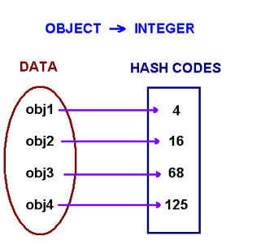
Introduction to hashing
Hashing is designed to solve the problem of needing to efficiently find or store an item in a collection.
For example, if we have a list of 10,000 words of English and we want to check if a given word is in the list, it would be inefficient to successively compare the word with all 10,000 items until we find a match.
Hashing is a technique to make things more efficient by effectively narrowing down the search at the outset.
What is hashing?
Hashing means using some function or algorithm to map object data to some representative integer value. This so-called hash code (or simplyhash) can then be used as a way to narrow down our search when looking for the item in the map.

Slide 23
How hashing works
To understand Hashing , we should understand the three terms first i.e
Hash Function ,
Hash Value and
Bucket
A hash function is a function which when given a key, generates an address in the table.
hashCode() function which returns an integer value is the Hash function. The important point to note that , this method is present in Object class ( Mother of all class ) . This is the code for the hash function(also known as hashCode method) in Object Class : public native int hashCode();
The most important point to note from the above line : hashCode method return int value . So the Hash value is the int value returned by the hash function .
.

Slide 24
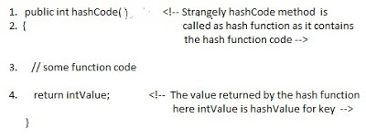
So summarize the terms in the diagram below :
A hash function that returns a unique hash number is called a universal hash function. In practice it is extremely hard to assign unique numbers to objects. The later is always possible only if you know (or approximate) the number of objects to be proccessed.
Thus, we say that our hash function has the following properties
it always returns a number for an object.
two equal objects will always have the same number
two unequal objects not always have different numbers

Slide 25
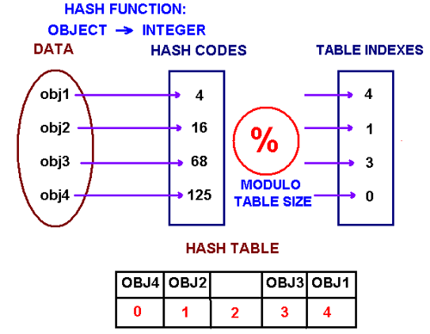
The precedure of storing objets using a hash function is the following.
Create an array of size M. Choose a hash function h, that is a mapping from objects into integers 0, 1, ..., M-1. Put these objects into an array at indexes computed via the hash function index = h(object). Such array is called a hash table.

Slide 26
How to choose a hash function
One approach of creating a hash function is to use Java's hashCode() method. The hashCode() method is implemented in the Object class and therefore each class in Java inherits it.
The hash code provides a numeric representation of an object (this is somewhat similar to the toString method that gives a text representation of an object).
Conside the following code example
Integer obj1 = new Integer(2009); String obj2 = new String("2009"); System.out.println("hashCode for an integer is " + obj1.hashCode()); System.out.println("hashCode for a string is " + obj2.hashCode());
It will printhashCode for an integer is 2009 hashCode for a string is 1537223
The method hasCode has different implementation in different classes. In the String class, hashCode is computed by the following formula
s.charAt(0) * 31^{n-1} + s.charAt(1) * 31^{n-2} + ... + s.charAt(n-1)
where s is a string and n is its length. An example"ABC" = 'A' * 31² + 'B' * 31 + 'C' = 65 * 31² + 66 * 31 + 67 = 64578

Slide 27
Note that Java's hashCode method might return a negative integer. If a string is long enough, its hashcode will be bigger than the largest integer we can store on 32 bits CPU. In this case, due to integer overflow, the value returned by hashCode can be negative.
What is bucket ? A bucket is used to store key value pairs . A bucket can have multiple key-value pairs . In hash map, bucket used simple linked list to store objects .
1. What are these Buckets ? Ans: The Buckets are placeholders for the keyValue pairs or objects. 2. who determines how many have to be created and whether the count is static or it can increase along with the collection? Ans : The initial size of the Collection determines the number of buckets that are created and its not static and the number of buckets gets almost doubled if the current size reaches 0.75% of the load and it could be modified. 3. Where are they stored ? Ans : They are stored on Heap along with the other objects. 4. Who creates them and how do they look like ie any datatype associated with them ? Ans : JVM creates them along with the creation of collection..

Slide 28
Collisions
When we put objects into a hashtable, it is possible that different objects (by the equals() method) might have the same hashcode. This is called a collision.
Here is the example of collision. Two different strings ""Aa" and "BB" have the same key: .
"Aa" = 'A' * 31 + 'a' = 2112 "BB" = 'B' * 31 + 'B' = 2112
How to resolve collisions?
Where do we put the second and subsequent values that hash to this same location? There are several approaches in dealing with collisions. One of them is based on idea of putting the keys that collide in a linked list! A hash table then is an array of lists!!
This technique is called a separate chaining collision resolution.

Slide 29
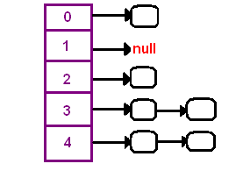
Another technique of collision resolution is a linear probing. If we cannoit insert at index k, we try the next slot k+1. If that one is occupied, we go to k+2, and so on. This is quite simple approach but it requires new thinking about hash tables. Do you always find an empty slot? What do you do when you reach the end of the table?
Conclusion
Hashing in its simplest form, is a way to assigning a unique code for any variable/object after applying any formula/algorithm on its properties.
A true Hashing function must follow this rule:
Hash function should return the same hash code each and every time, when function is applied on same or equal objects. In other words, two equal objects must produce same hash code consistently.

Slide 30
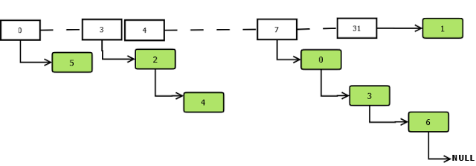
Internally Working of Hashmap
HashMap works on the principle of Hashing.
In HashMap, the data structure is based on array and linked list.
An entry finds its location in the array based on its hash value.
If an array element is already occupied, the new entry replaces the old entry and the old entry is linked to the new one. Below is an example of the entries in the data structure.

Slide 31
Key points to Remeber:
HashMap is a collection class that is designed to store elements as key-value pairs. Maps provide a way of looking up one thing based on the value of another.
HashMap has a inner class called Entry which stores key-value pairs.
Above Entry object is stored in Entry[ ](Array) called table
An index of table is logically known as bucket and it stores first element of linkedlist
Key object’s hashcode() is used to find bucket of that Entry object.
If two key object ‘s have same hashcode , they will go in same bucket of table array.
Key object ‘s equals() method is used to ensure uniqueness of key object.
Value object ‘s equals() and hashcode() method is not used at all

Slide 32
Entry class
A map by definition is : “An object that maps keys to values”.
So, there must be some mechanism in HashMap to store this key value pair. HashMap has an inner class Entry, which looks like this:
static class Entry<K ,V> implements Map.Entry<K ,V>
{
final K key;
V value;
Entry<K ,V> next;
final int hash;
...//More code goes here
}
Surely Entry class has key and value mapping stored as attributes. Key has been marked as final and two more fields are there: next and hash.
HashMap get(Key k) method calls hashCode method on the key object and applies returned hashValue to its own static hash function to find a bucket location(backing array) where keys and values are stored in form of anested class called Entry (Map.Entry) . So you have concluded that from the previous line that Both key and value is stored in the bucket as a form of Entry object

Slide 33
What put() method actually does
Instances of Entry class are stored in an array. HashMap class defines this variable as:
* The table, resized as necessary. Length MUST Always be a power of two.
*/
transient Entry[] table;
Now look at code implementation of put() method:
public V put(K key, V value) {
if (key == null)
return putForNullKey(value);
int hash = hash(key.hashCode());
int i = indexFor(hash, table.length);
for (Entry<K , V> e = table[i]; e != null; e = e.next) {
Object k;
if (e.hash == hash && ((k = e.key) == key || key.equals(k))) {
V oldValue = e.value;
e.value = value;
e.recordAccess(this);
return oldValue;
}
}
modCount++;
addEntry(hash, key, value, i);
return null;
}

Slide 34
Lets note down steps by Step:
1) First of all, key object is checked for null. If key is null, value is stored in table[0] position. Because hash code for null is always 0.
2) Then on next step, a hash value is calculated using key’s hash code by calling its hashCode() method. This hash value is used to calculate index in array for storing Entry object.
3) Now indexFor(hash, table.length) function is called to calculate exact index position for storing the Entry object.
Now, as we know that two unequal objects can have same hash code value, how two different objects will be stored in same array location [called bucket]. Answer is LinkedList. If you remember, Entry class had an attribute “next”. This attribute always points to next object in chain. This is exactly the behavior of LinkedList.
So, in case of collision, Entry objects are stored in LinkedList form.
When an Entry object needs to be stored in particular index, HashMap checks whether there is already an entry?? If there is no entry already present, Entry object is stored in this location.

Slide 35
How get() methods works internally
what happens when an object is passed in get method of HashMap? How the value object is determined?
We already know that the way key uniqueness is determined in put() method , same logic is applied in get() method also. The moment HashMap identify exact match for the key object passed as argument, it simply returns the value object stored in current Entry object.
If no match is found, get() method returns null.
Let have a look at code:
public V get(Object key) {
if (key == null)
return getForNullKey();
int hash = hash(key.hashCode());
for (Entry<K , V> e = table[indexFor(hash, table.length)]; e != null; e = e.next) {
Object k;
if (e.hash == hash && ((k = e.key) == key || key.equals(k)))
return e.value;
}
return null;

Slide 36
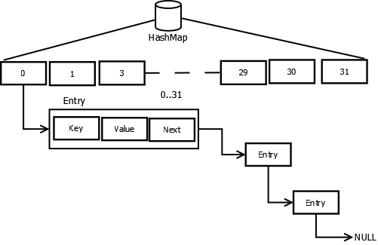
Collision
If two different key objects return the same hashcode, it will result in collision as the bucket location would be same. The new entry will replace the previous entry and the next reference of the new entry will point to the previous entry. For hash tables, this means that the second table insertion will be slower as the links have to be adjusted.
Hashmap Collision

Slide 37
Capacity
The default initial capacity MUST be a power-of-two. Even if the caller provides a capacity c which is 2^{x-1} > c < 2^{x}, the capacity is converted to 2^{x} to create the internal array.
If the capacity of array is in power-of-two, the hash code can be easily converted to the index based on a simple AND operation:
index = hashCode & (length-1).
Here length = 2^{x.} In Hashtable, the capacity doesn't need to be in power of 2 and the internal array is created for whatever capacity is provided but the index calculation is based on modulus operand: index = (hashCode & 0x7FFFFFFF) % length.Since the capacity is in power of 2, a simple AND operation is able to return us the index.

Slide 38
Lets see how it works using an example. Suppose the hash=311 and length=16, applying the modulus operation we get: hash = 16 * 19 + 7 (length*quotient + index), thus index = 7. Let us convert the hash to binary. 311 = 1 0011 0111 in binary = 1 0011 0111 = 1 0011 0000 + 0111 = 2⁴*1 + 2⁵*1 + 2⁶*0 + 2⁷*0 + 2⁸*1 + 0111 = 2⁴(2⁰*1 + 2¹*1 + 2²*0 + 2³*0 + 2⁴*1) + 0111 = 2⁴(10011) + 0111 This is in the same form as the length*quotient + index, here index = 0111, thus if length=2^{x}, index is nothing but the lower x bits of hash code. We can obtain these lower bits by doing & operation. index = 0111 = 1 0111 0111 & 1111 Thus index = hash & (2^{length} - 1).
public void testFindModulusByAND() { int n = 311; int d = 1 << 4; int m = 7; assertEquals(m, n & (d -1)); }

Slide 39
ConcurrentHashMap
ConcurrentHashMap main motive is to allow concurrent access to the map.
HashTable offers synchronized access to the map but the entire map is locked to perform any sort of operation.
In ConcurrentHashMap, the basic strategy is to subdivide the table among segments so that the lock is applied only on a segment rather than the entire table. Each segment manages its own internal hash table in size 2^{x} >=(capacity/no. of segments).
Locking is applied only for updates. In case of of retrievals, it allows full concurrency, retrievals reflect the results of the most recently completed update operations.
If we assume four threads are going to concurrently work on a map of initial capacity 32, we would want the table to be partitioned into four segments, each managing a hash table of capacity 8.

Slide 40
ConcurrentHashMap is a concurrent Collection class introduced in Java 5 Concurrency API.
ConcurrentHashMap implements Map interface like, HashMap and Hashtable but it is thread-safe collection and it achieves its thread-safety in a slightly different way than Hashtable and other thread-safe Collection class.
As ConcurrentHashMap allows concurred read operations and same time, maintains integrity by synchronizing write operations.
ConcurrentHashMap performs better than earlier two because it only locks a portion of Map, instead of whole Map, which is the case with Hashtable and synchronized Map.
HashMap class is fail-fast which means that if the HashMap will be changed while some thread is traversing over it using iterator, the iterator.next() will throw a ConcurrentModificationException.
But Iterator of ConcurrentHashMap is fail-safe and doesn’t throw ConcurrentModificationException even if underlying ConcurrentHashMap is modified once Iteration begins. Consequently all the updates made on ConcurrentHashMap is not available to Iterator.

Slide 41
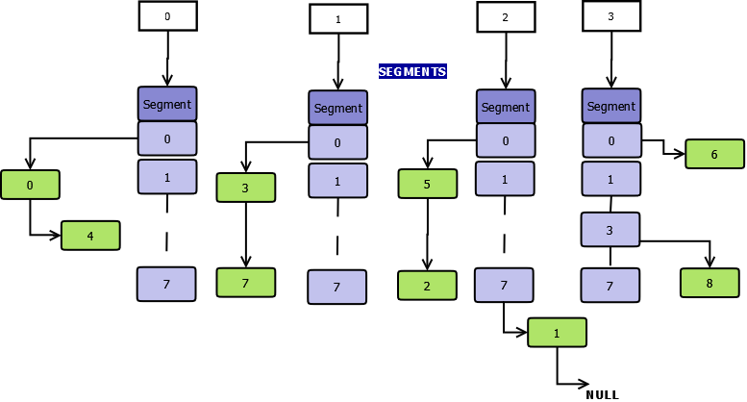
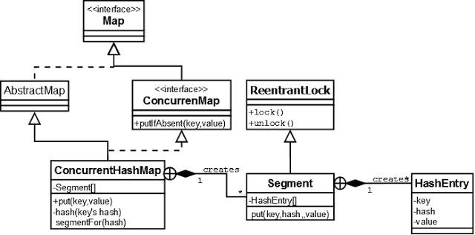
ConcurrentHashMap Data Structure would be:

Slide 42
Segment
The collection maintains a list of 16 segments by default, each of which is used to guard (or lock on) a single bucket of the map. This effectively means that 16 threads can modify the collection at a single time (as long as they’re all working on different buckets). This level of concurrency can be increased using the optional concurrencyLevel constructor argument.
public ConcurrentHashMap(int initialCapacity, float loadFactor, int concurrencyLevel)
The maximum size it can go up to is 2¹⁶. Greater the concurrency level, greater would be the no. of segments and lesser the size of hash table that the segment manages. Using a significantly higher value than you need can waste space and time, and a significantly lower value can lead to thread contention.
Put If Absent
ConcurrentMap offers new method putIfAbsent() which is similar to put except that the value will not be overridden if key already exists. This is equivalent to
if (!map.containsKey(key))
return map.put(key, value);
else return map.get(key);
except that the action is performed atomically.
The new method putIfAbsent is a bit faster as it avoids double traversing. It goes through the same internal flow as put, avoids overriding the old value if key already exists and simply returns the old value.

Slide 43
Though this code will work fine in HashMap and Hashtable,
This won't work in ConcurrentHashMap; because, during put operation whole map is not locked, and while one thread is putting value, other thread's get() call can still return null which result in one thread overriding value inserted by other thread.
Ofcourse, you can wrap whole code in synchronized block and make it thread-safe but that will only make your code single threaded.
ConcurrentHashMap provides putIfAbsent(key, value) which does same thing but atomically and thus eliminates above race condition.
When to use ConcurrentHashMap in Java
ConcurrentHashMap is best suited when you have multiple readers and few writers.
If writers outnumber reader, or writer is equal to reader, than performance of ConcurrentHashMap effectively reduces to synchronized map or Hashtable.
Performance of CHM drops, because you got to lock all portion of Map, and effectively each reader will wait for another writer, operating on that portion of Map.
ConcurrentHashMap is a good choice for caches, which can be initialized during application start up and later accessed my many request processing threads.
As javadoc states, CHM is also a good replacement of Hashtable and should be used whenever possible, keeping in mind, that CHM provides slightly weaker form of synchronization than Hashtable.

Slide 44
Complete code example of the ConcurrentHashMap:
import java.util.Iterator;
import java.util.concurrent.ConcurrentHashMap;
public class ConcurrentHashMapIterator { public static void main(String[] args) { ConcurrentHashMap myMap = new ConcurrentHashMap();
myMap.put("1", "One");
myMap.put("2", "Two");
myMap.put("3", "Three");
myMap.put("4", "Four");
myMap.put("5", "Five");
Iterator it = myMap.keySet().iterator();
while (it.hasNext()) { String key = it.next();
if (key.equals("3")) { myMap.put("6", "Six"); } } } }
In the above code, we are not getting ConcurrentModificationException, because ConcurrentHashMap allows multiple readers to read concurrently without any blocking.
This is achieved by partitioning Map into different parts based on concurrency level and locking only a portion of Map during updates.
Default concurrency level is 16, and accordingly Map is divided into 16 part and each part is goverened with different lock.
This means, 16 thread can operate on Map simulteneously, until they are operating on different part of Map.
This makes ConcurrentHashMap high performant despite keeping thread-safety intact.

Slide 45
Summary
Now we know What is ConcurrentHashMap in Java and when to use ConcurrentHashMap, it’s time to know and revise some important points about CHM in Java.
1. ConcurrentHashMap allows concurrent read and thread-safe update operation.
2. During update operation, ConcurrentHashMap only lock a portion of Map instead of whole Map.
3. Concurrent update is achieved by internally dividing Map into small portion which is defined by concurrency level.
4. Choose concurrency level carefully as a significant higher number can be waste of time and space and lower number may introduce thread contention in case writers over number concurrency level.
5. All operations of ConcurrentHashMap are thread-safe.
6. Since ConcurrentHashMap implementation doesn't lock whole Map, there is chance of read overlapping with update operations like put() and remove(). In that case result returned by get() method will reflect most recently completed operation from there start.
7. Iterator returned by ConcurrentHashMap is weekly consistent, fail safe and never throw ConcurrentModificationException. In Java.
8. ConcurrentHashMap doesn't allow null as key or value.
9. You can use ConcurrentHashMap in place of Hashtable but with caution as CHM doesn't lock whole Map.

Slide 46
Weak hash map
WeakHashMap is designed based on hashtable implementation with weak keys.
Elements of WeakHashMap will be removed when its key is no longer in use,once key is discared it cannot be recreated
The keys of WeakHashMap stored as the reference of a weak reference,keys will discarded only after key refers as the weak references to it, inside and outside of the map have been cleared by garbage collector
A WeakHashMap is a special Map implementation where the keys of the map are stored in ajava.lang.ref.WeakReference. By storing the keys in a weak reference, key-value pairs can dynamically be dropped from the map when the only reference to the key is from the weak reference. This makes the WeakHashMap an excellent implementation for a weakly referenced list, where entries that aren't used elsewhere may be dropped with no side effects. Also, just because a key may be dropped, doesn't mean it will immediately be dropped. If the system has sufficient resources, the weak key reference that isn't externally referenced could stay around for a long time.
You can use a WeakHashmap to reduce the chance of a memory leak as a result of caching some object. The WeakHashMap will automatically remove entries whenever all references to the key are removed.

Slide 47
Elements in a weak hashmap can be reclaimed by the garbage collector if there are no other strong references to the object, this makes them useful for caches/lookup storage.
import java.util.Map;
import java.util.WeakHashMap;
public class WeakHashMapExample { public static void main(String[] args) { Map<String, String> weakHashMap = new WeakHashMap<String, String>(); String key1 = new String("1");
String key2 = new String("2");
String key3 = new String("3");
String key4 = "4"; String key5 = "5";
weakHashMap.put(key1, "One");
weakHashMap.put(key2, "Two");
weakHashMap.put(key3, "Three");
weakHashMap.put(key4, "Four");
weakHashMap.put(key5, "Five");
System.gc();
System.out.println(weakHashMap);
key2 = null; System.gc();
System.out.println(weakHashMap); } }
WeakHashMapExample.java
{4=Four, 5=Five, 1=One, 2=Two, 3=Three} {4=Four, 5=Five, 1=One, 3=Three}

Slide 48
What is the purpose of WeakHashMap when there is HashMap and Concurrent HashMap?
WeakHashMap is an implementation of Map interface where the memory of the value object can be reclaimed by Grabage Collector if the corresponding key is no longer referred by any section of program. So if key is no longer used in program. its Entry object will be garbage collected irrespective of its usage. Its clear till here
This is different from HashMap where the value object remain in HashMap even if key is no longer referred. We need to explicitly call remove() method on HashMap object to remove the value. calling remove will just remove the entry from map. Its readyness for GC will depend whether it is still used somewhere in program or not.
We should go for WeakHashMap only when we want to ensure that key-value pair is removed from map on GC run when key is no longer in ordinary use other than map itself.

Slide 49
IdentityHashMap
IdentityHashMap uses equality operator (==) to compare keys and values
IdentityHashMap occupies less memory when compared hashmap
IdentityHashMap Example Program
import java.util.HashMap;
import java.util.IdentityHashMap;
import java.util.Map;
public class IdentityHashMapExample { public static void main(String[] args) { Map<String,String> hashMap = new HashMap<String,String>(); Map<String,String> identityHashMap = new IdentityHashMap<String,String>();
String key[] = {"1","2","3","4","5"};
String val[] = {"One","Two","Three","Four","Five"};
for (int i = 0; i <key.length; i++) { hashMap.put(new String(key[i]), val[i]); identityHashMap.put(new String(key[i]), val[i]); } System.out.println("HashMap--->"+hashMap); System.out.println("IdentityHashMap--->"+identityHashMap); for (int i = 0; i <key.length; i++)
{ hashMap.put(key[i], val[i]);
identityHashMap.put(new String(key[i]), val[i]); } System.out.println("HashMap--->"+hashMap); System.out.println("IdentityHashMap--->"+identityHashMap); } }

Slide 50
IdentityHashMapExample.java
HashMap--->{3=Three, 2=Two, 1=One, 5=Five, 4=Four} IdentityHashMap--->{1=One, 3=Three, 5=Five, 4=Four, 2=Two} HashMap--->{3=Three, 2=Two, 1=One, 5=Five, 4=Four} IdentityHashMap--->{5=Five, 4=Four, 1=One, 3=Three, 3=Three, 5=Five, 1=One, 2=Two, 4=Four, 2=Two}
This class implements AbstractMap. It is similar to HashMap except that it uses reference equality when comparing elements.
This class is not a general-purpose Map implementation. While this class implements the Map interface, it intentionally violates Map's general contract, which mandates the use of the equals method when comparing objects.
This class is designed for use only in the rare cases wherein reference-equality semantics are required.
This class provides constant-time performance for the basic operations (get and put), assuming the system identity hash function (System.identityHashCode(Object)) disperses elements properly among the buckets.
This class has one tuning parameter (which affects performance but not semantics): expected maximum size. This parameter is the maximum number of key-value mappings that the map is expected to hold.
The IdentityHashMap class supports three constructors. The first form constructs a new, empty identity hash map with a default expected maximum size (21):

Slide 51
CopyOnWriteArrayList
CopyOnWriteArrayList is a thread safe arraylist.
Writing elements in CopyOnWriteArrayList
Make Copy of whole list whenever element is inserted or updated to the list, so list too costlier for write operations.
CopyOnWriteArrayList will be useful when list size is small and when the list is not require to be synchronized.
List elements cannot be changed while iterating elements using iterator, iterator do not add/modify the list during iteration. Iterator will not throw ConcurrentModificationException,since it uses copy of the list.
CopyOnWriteArrayList allows duplicates and null values.
In below example, ArrayList uses iterator and iterator throws concurrentModificationException.
ArrayList throws ConcurrentModificationException

Slide 52
import java.util.ArrayList;
import java.util.Iterator;
java.util.List;
class ArrayListConcurrentModificimport ationExceptiopublic n {
public static void main(String[] args) {
List<Integer> list = new ArrayList<Integer>();
list.add(1); list.add(2);
list.add(3); list.add(4);
);
Iterator<Integer> it = list.iterator();
int i = 6; while(it.hasNext()){
int val = it.next(); list.add(i); //Throws ConcurrentModificationException System.out.println(val); i++; } System.out.println(list); } }

Slide 53
fail safe and fail fast iterator
"Fail safe" means: it won't fail.
"Fail fast" means: it may fail ... and the failure condition is checked aggressively so that the failure condition is detected before damage can be done.
As name suggest fail-fast Iterators fail as soon as they realized that structure of Collection has been changed since iteration has begun. Structural changes means adding, removing or updating any element from collection while one thread is Iterating over that collection.
fail-fast behavior is implemented by keeping a modification count and if iteration thread realizes the change in modification count it throwsConcurrentModificationException.
The only difference is fail-safe iterator doesn't throw any Exception, contrary to fail-fast Iterator, if Collection is modified structurally while one thread is iterating over it.
This is because they work on clone of Collection instead of original collection and that’s why they are called as fail-safe iterator.
Iterator of CopyOnWriteArrayList is an example of fail-safe Iterator also iterator written by ConcurrentHashMap keySet is also fail-safe iterator and never throw ConcurrentModificationException in Java.

Slide 54
continued
fail-safe Iterator in java
Contrary to fail-fast Iterator, fail-safe iterator doesn't throw any Exception if Collection is modified structurally
while one thread is Iterating over it because they work on clone of Collection instead of original collection and that’s why they are called as fail-safe iterator.
Iterator of CopyOnWriteArrayList is an example of fail-safe Iterator also iterator written by ConcurrentHashMap keySet is also fail-safe iterator and never throw ConcurrentModificationException in Java.
Iterators from java.util package throw ConcurrentModificationException if collection was modified by collection's methods (add / remove) while iterating
Iterators from java.util.concurrent package typically iterate over a snapshot and allow concurrent modifications but may not reflect collection updates after the iterator was created.
Java docs of fail-fast iterators says “Note that the fail-fast behavior of an iterator cannot be guaranteed as it is, generally speaking, impossible to make any hard guarantees in the presence of unsynchronized concurrent modification. Fail-fast iterators throw {@code ConcurrentModificationException} on a best-effort basis. Therefore, it would be wrong to write a program that depended on this exception for its correctness: the fail-fast behavior of iterators should be used only to detect bugs.”

Slide 55
java docs of fail-safe iterators says “This is ordinarily too costly, but may be more efficient than alternatives when traversal operations vastly outnumber mutations, and is useful when you cannot or don’t want to synchronize traversals, yet need to preclude interference among concurrent threads. The “snapshot” style iterator method uses a reference to the state of the array at the point that the iterator was created. This array never changes during the lifetime of the iterator, so interference is impossible and the iterator is guaranteed not to throwConcurrentModificationException.The iterator will not reflect additions, removals, or changes to the list since the iterator was created. Element-changing operations on iterators themselves (remove(), set(), and add()) are not supported. These methods throw UnsupportedOperationException.”

Slide 56
Example of Fail Fast Iterator and Fail Safe Iterator
import java.util.HashMap;
import java.util.Iterator;
import java.util.Map;
public class FailFastExample {
public static void main(String[] args) {
Map<String,String> premiumPhone = new HashMap<String,String>(); premiumPhone.put("Apple", "iPhone");
premiumPhone.put("HTC", "HTC one");
premiumPhone.put("Samsung","S5");
Iterator iterator = premiumPhone.keySet().iterator();
while (iterator.hasNext()) { System.out.println(premiumPhone.get(iterator.next())); premiumPhone.put("Sony", "Xperia Z"); } } }
Output : iPhone Exception in thread "main" java.util.ConcurrentModificationException at java.util.HashMap$HashIterator.nextEntry(Unknown Source) at java.util.HashMap$KeyIterator.next(Unknown Source) at FailFastExample.main(FailFastExample.java:20)

Slide 57
Fail Safe Iterator Example :
import java.util.concurrent.ConcurrentHashMap;
import java.util.Iterator;
public class FailSafeExample { public static void main(String[] args) { ConcurrentHashMap<String,String> premiumPhone = new ConcurrentHashMap<String,String>();
premiumPhone.put("Apple", "iPhone");
premiumPhone.put("HTC", "HTC one");
premiumPhone.put("Samsung","S5");
Iterator iterator = premiumPhone.keySet().iterator();
while (iterator.hasNext()) { System.out.println(premiumPhone.get(iterator.next())); premiumPhone.put("Sony", "Xperia Z"); } } }
Output : S5
HTC
one iPhone

Slide 58
 | Fail Fast Iterator | Fail Safe Iterator
Throw ConcurrentModification Exception | Yes | No
Clone object | No | Yes
Memory Overhead | No | Yes
Examples | HashMap,Vector,ArrayList,HashSet | CopyOnWriteArrayList,ConcurrentHashMap

Slide 59
Thank You..

